Slide 1
Decision Tree learning

Slide 2
Outlook =sunny, play=yes
Outlook =rain, play=no
Outlook=rain, play=?

Slide 3
Outlook =sunny, temperature=hot, play=yes
Outlook =rain, temp=hot, play=no
Outlook =sunny, temperature=cool, play=yes
Outlook =rain, temp=cool, play=no
Outlook= rain, temp=hot, play=?
Outlook= rain, temp=cool, play=?

Slide 4
Learning function is represented by a decision tree.
Re-represented as sets of if-then rules to improve human readability.
Diagnose medical cases.
Assess credit risk.

Slide 5
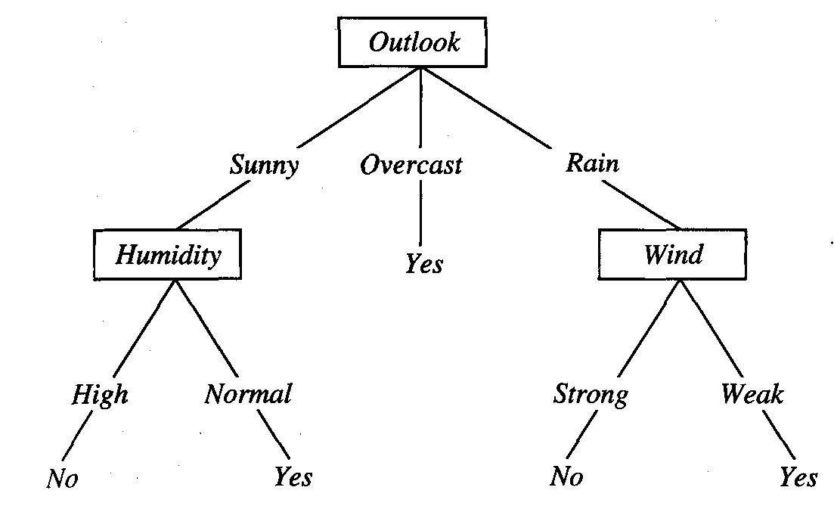

Slide 6
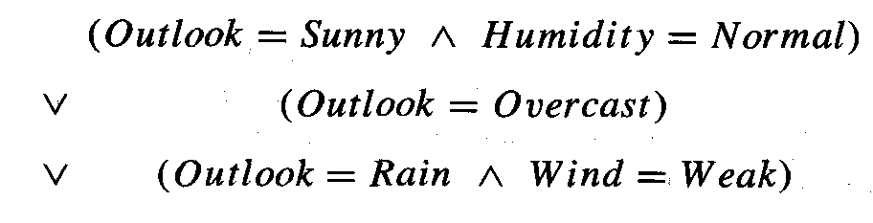
Decision tree represents a disjunction of conjunctions of constraints on the attribute values of instances.

Slide 7
Which attribute is best classifier
Top down greedy search through the space of possible decision tree.
ID3, starts with deciding the best root for tree.
Information gain measures how well a given attribute separates the training examples according to their target classification.

Slide 8
Entropy
Measures homogeneity of examples.
Characterizes the im(purity) of an arbitrary collection of examples.
Given a collection S, containing positive and negative examples of some target concept, the entropy of S would be
Entropy(S)= -(p₊log₂p₊)-(p₋log₂p₋)
P₊ is proportion of positive example and p₋ proportion of negative example

Slide 9
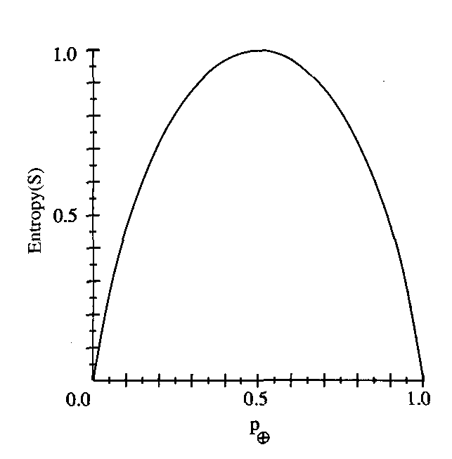
Entropy([9+, 5-]) = ?

Slide 10
Entropy from information theory points of view is that it specifies the minimum number of bits of information needed to encode the classification of an arbitrary member of S.

Slide 11
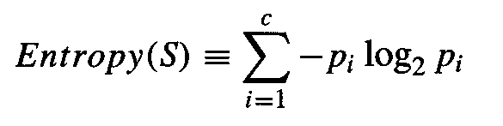
If target attribute can take on c different values then
Where p_{i} is the proportin of S belonging to class i.

Slide 12
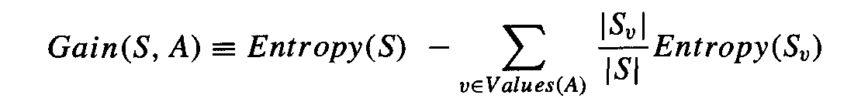
Infromation gain(IG)
Measures the expected reduction in entropy.
It is expected reduction in entropy caused by partitioning the examples according to this attribute.
Gain(S,A) of an attribute A, is defined as

Slide 13
Where Values(A) is the set of all possible values for attribute A, and S_{v} is the subset of S for which attribute A has value v.
Values(wind) = weak, strong
S = [9+,5-]
S_{WEAK} = [6+,2-]
S_{STRONG} = [3+, 3-]

Slide 14
The value of Gain(S,A) is the number of bits saved when encoding the target value of an arbitrary member of S, by knowing the value of attribute A.

Slide 15
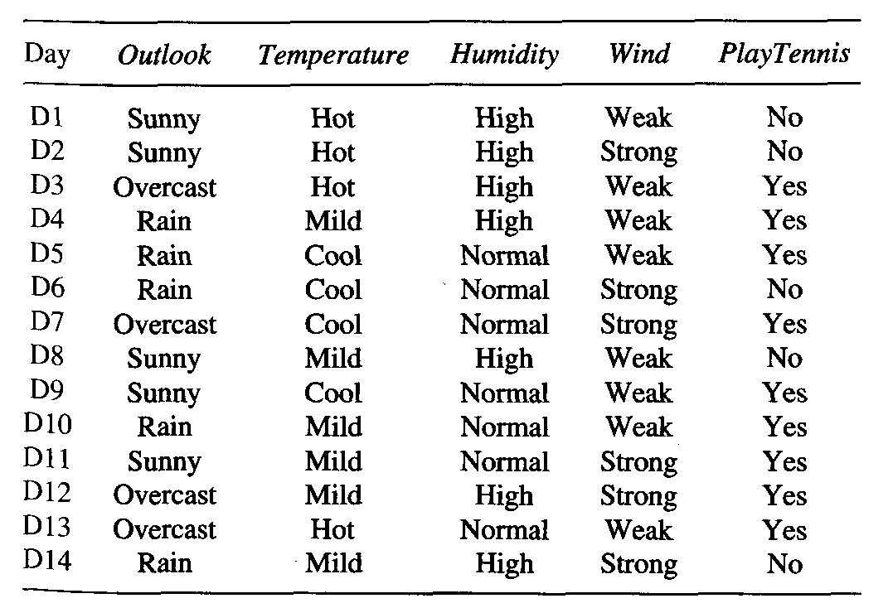

Slide 16
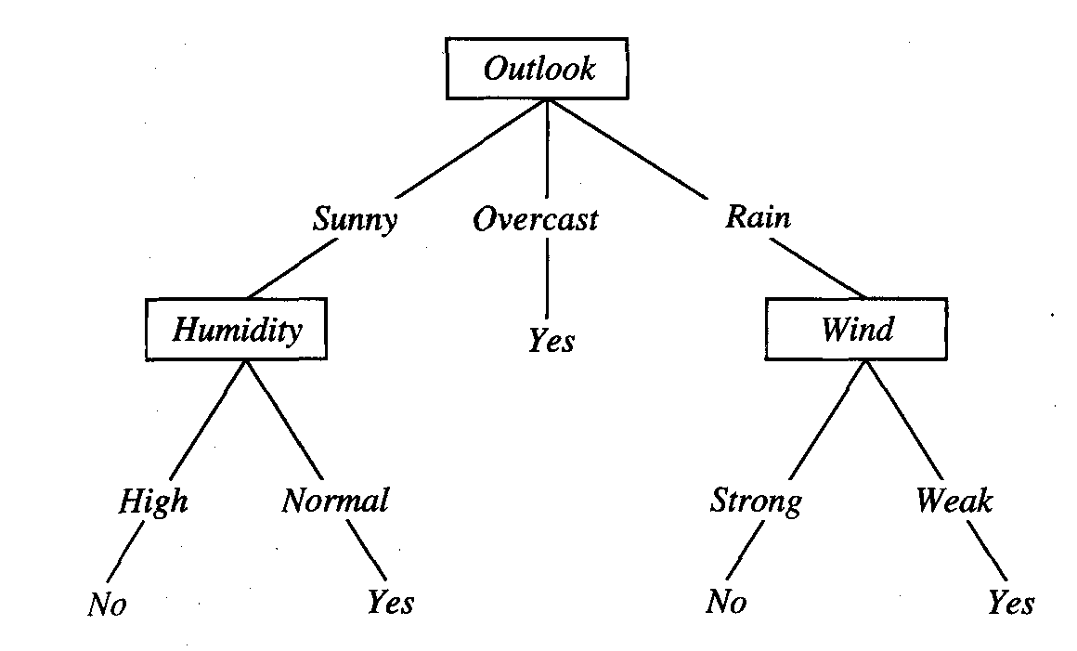

Slide 17
Hypothesis space search in decision tree
Hypothesis space of DT is a complete space of finite discret-valued functions, relative to the available attributes.
ID3 maintains only a single current hyposthesis as it searches through the space of decision tree.
ID3 performs no back tracking.

Slide 18
Issues in DT Learning
How deeply to grow DT.
Handling continous attributes.
Choosing an appropraite attribute selection measure.
Handling training data with missing att values.
Improving computational cost.

Slide 19
Avoiding overfitting of data
Definition: Given a hypothesis space H, a hypothesis h belongs to H is said to overfit the training data if there exists some alternative hypothesis h' belongs to H, such that h has smaller error than h' over the training examples, but h' has a smaller error than h over the entire distribution of instances

Slide 20
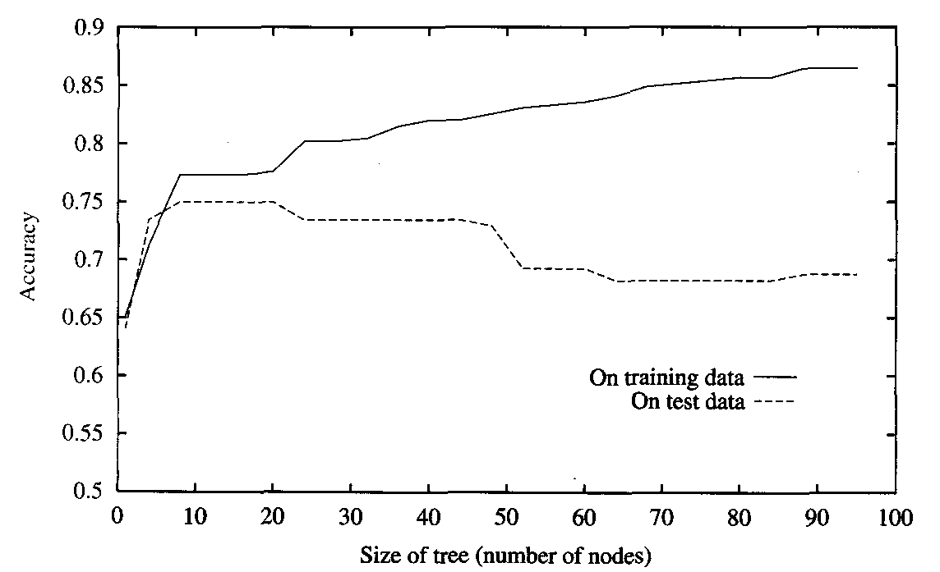

Slide 21
Reason of overfitting
Noisy data
insufficient training examples

Slide 22
How to avoid overfit
Approaches that stop growing tree earlier, before it reaches the point where it perfectly classifies the training data.
Approaches that allow the tree to overfit the data and then post-prune the tree.
Criteria- validation.

Slide 23
Reduced error pruning
Consider each node to be candidates for pruning.
Pruning a decision node consists of removing the subtree rooted at that node, making it a leaf node, and assigning it the most common classification of the training examples affiliated with that node.
Nodes are removed only if the resulting pruned tree performs no worse than-the original over the validation set

Slide 24
This has the effect that any leaf node added due to coincidental regularities in the training set is likely to be pruned because these same coincidences are unlikely to occur in the validation set.

Slide 25
